Slide 1
Introduction to HTML

Slide 3
What is HTML?
HTML stands for Hyper Text Markup Language
HTML is the standard markup language for creating Web pages
HTML describes the structure of a Web page
It was introduced by Tim Berners-Lee in 1991
HTML consists of a series of elements
HTML elements tell the browser how to display the content
HTML elements label pieces of content such as "this is a heading", "this is a paragraph", "this is a link", etc.
Web Browsers:
The purpose of a web browser (Chrome, Edge, Firefox, Safari) is to read HTML documents and display them correctly.

Slide 4
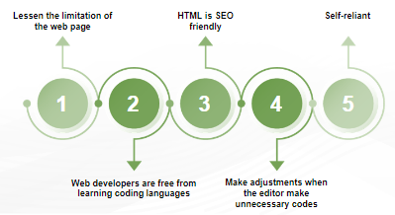
Why HTML?
Features of HTML
It is easy to learn and easy to use.
It is platform-independent.
Images, videos, and audio can be added to a web page.
Hypertext can be added to the text.
It is a markup language.

Slide 5
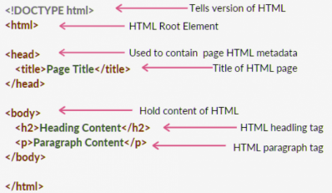
HTML Page Structure
Notes:
<!DOCTYPE html> – This is the document type declaration (not technically a tag). It declares a document as being an HTML document. The doctype declaration is not case-sensitive.
<html> – This is called the HTML root element. All other elements are contained within it.
<head> – The head tag contains the “behind the scenes” elements for a webpage. Elements within the head aren’t visible on the front end of a webpage.
<title> – The title is what is displayed on the top of your browser when you visit a website and contains the title of the webpage that you are viewing.
<body> – The body tag is used to enclose all the visible content of a webpage. In other words, the body content is what the browser will show on the front end.

Slide 6
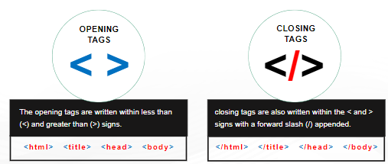
HTML Elements
An HTML element is defined by a start tag, some content, and an end tag.
HTML uses predefined tags and elements that instruct the browser on how to display the content.
<tagname> Content goes here... </tagname>
The HTML element is everything from the start tag to the end tag:
<h1>My First Heading</h1>
<p>My first paragraph.</p>

Slide 7
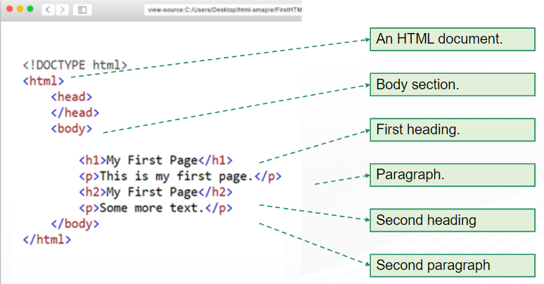

Slide 8
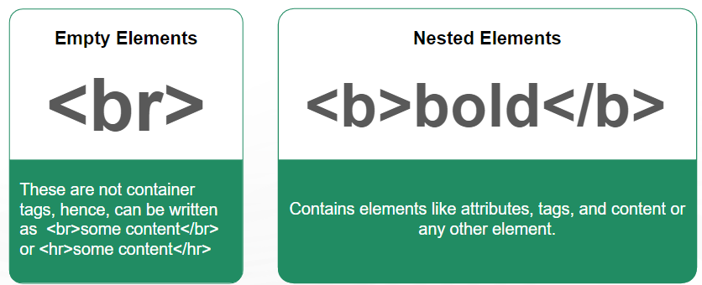
Identifying HTML documents
Elements are special keywords that HTML uses to structure a website.
It also helps in styling a website.

Slide 9
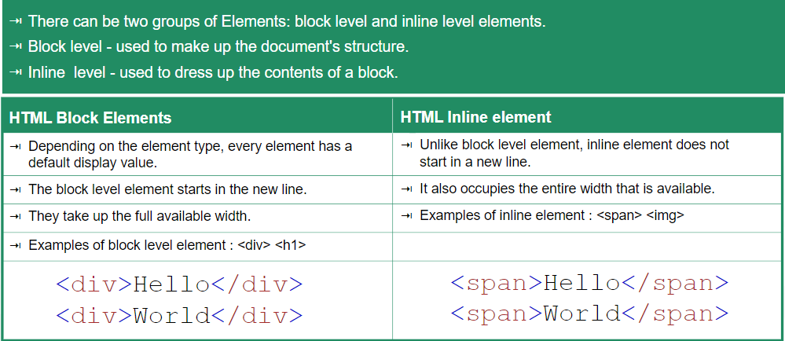

Slide 10
Block level elements in HTML are:
<address>, <article>, <blockquote>, <aside>, <div>, <canvas>, <dd>, <dt>, <dl>, <fieldset>, <figure>, <figcaption>, <footer>, <form>, <header>, <hr>, <h1>-<h6>, <li>, <main>, <nav>, <noscript>, <ol>, <p>, <section>, <pre>, <table>, <tfoot>, <ul>, <video>
In-line elements in HTML are:
<a>, <abbr>, <acronym>, <b>, <bdo>, <big>, <br>, <button>, <cite>, <code>, <dfn>, <em>, <i>, <img>, <input>, <kbd>, <label>, <map>, <object>, <output>, <q>, <samp>, <script>, <select>, <small>, <span>, <strong>, <sub>, <sup>, <textarea>, <time>, <tt>, <var>

Slide 11
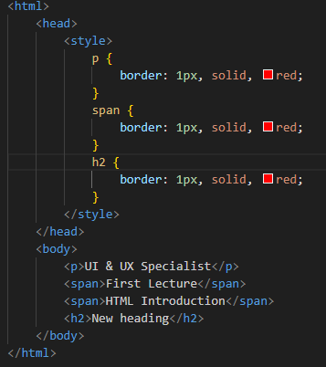

Slide 12
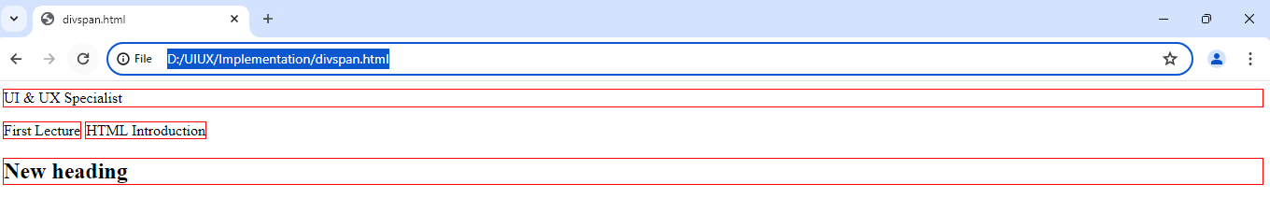

Slide 13
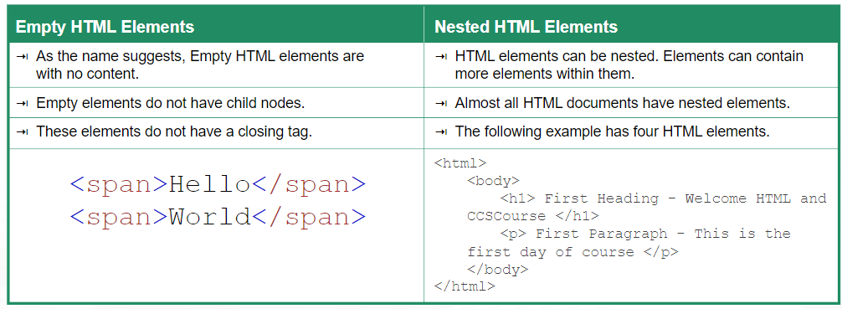
Empty HTML elements

Slide 14
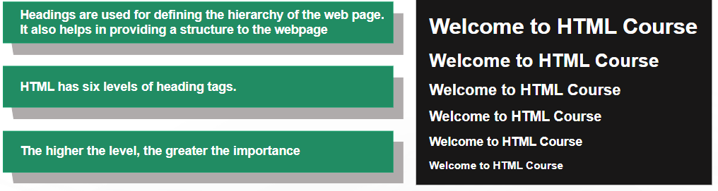
HTML Headings
Syntax:
// the 'h' inside the tag should be in small case only. <h1>Heading1</h1> <h2>Heading2</h2>
……………………..
<h6>Heading6</h6>

Slide 15
Purpose and Usage of Heading Tags:
1. <h1> – Main Heading (Largest):
Represents the primary topic of the page.
Use it sparingly to maintain clarity.
2. <h2> – Subheadings:
Ideal for dividing content into sections.
If further subsections exist, employ <h3> elements.
3. <h3> to <h6> – Smaller Headings:
Gradually decrease in size.
Use them for finer subdivisions.
Why Do Headings are Important?
SEO Impact:
Search engines index headings to understand content structure.
Well-organized headings enhance visibility and ranking.
2. Highlighting Key Topics:
Headings emphasize essential information.
Readers quickly grasp the document’s structure.

Slide 16
HTML Paragraphs
The <p> tag in HTML signifies a paragraph. Enclosed within the opening <p> and closing </p> tags, any content is recognized as a paragraph.
As a block-level element, a new paragraph inherently starts on a fresh line, with browsers intuitively adding space before and after a paragraph for enhanced readability.
Syntax: <p> content </p>
Properties of the paragraph Tag
The browser reduces multiple spaces added by users to a single space.
If a user adds multiple lines, the browser compresses them into a single line.
By default, the display of the paragraph element is set to “block,” meaning each new paragraph is placed on a new line. This behavior can be modified using CSS.

Slide 17
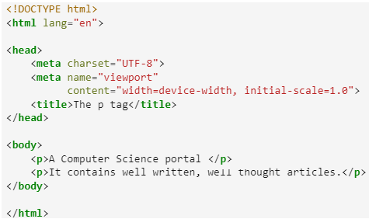
Example 1
Output:
A Computer Science portal
It contains well written, well thought articles.

Slide 18
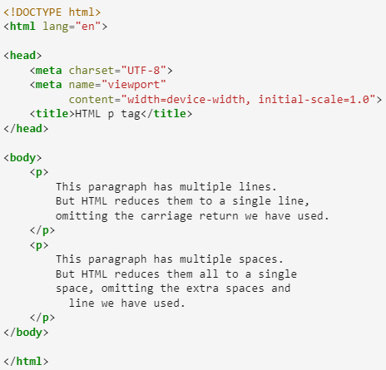
Example 2: <p> tag having multiple lines.
Output:

Slide 19
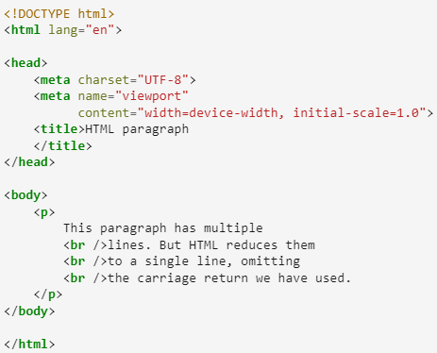
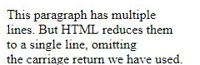
The <br> tag
The HTML <br> tag element creates a line break, giving you a new line without starting a new paragraph. Use <br> when you want to move to the next line without beginning a whole new paragraph.
Output:

Slide 20
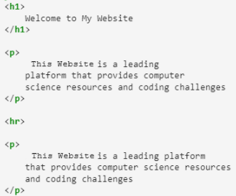
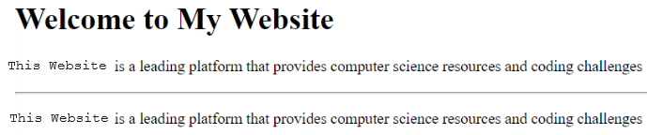
The <hr> tag
The HTML <hr> tag is used to create a horizontal rule or line, visually separating content on a webpage. Use <hr> when you want to insert a horizontal line to signify a division between sections or elements, providing a clear visual break in the page.
Output:

Slide 21
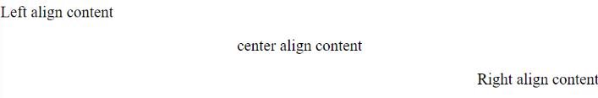
<p> align Attribute
The HTML <p> align attribute is used to specify the alignment of paragraph text content. The align attribute aligns text horizontally within a paragraph.
Note: The align attribute for the <p> tag is deprecated in HTML5. Use CSS properties like text-align for precise alignment instead.
Syntax:
<body>
<p align=“left">
Left align content </p>
<p align=“center">
Center align content
</p>
<p align="right">
Right align content
</p>
</body>
<p align="left | right | center | justify">

Slide 22
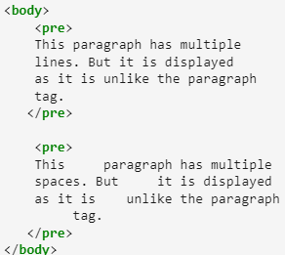
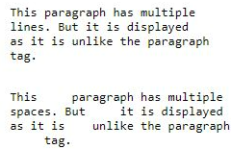
The <pre> tag
The HTML <pre> tag is used for pre-formatted text. It keeps the original spaces and line breaks exactly as they are in the code. When you use <pre>, the text appears in a fixed-width font, preserving the formatting and layout just as it looks in the HTML code.
Output:

Slide 23
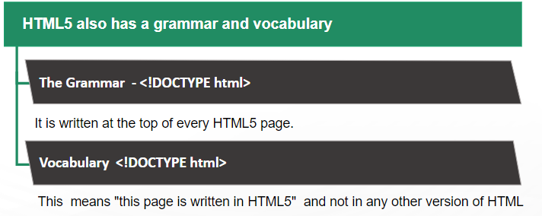
<!DOCTYPE> in HTML5

Slide 24
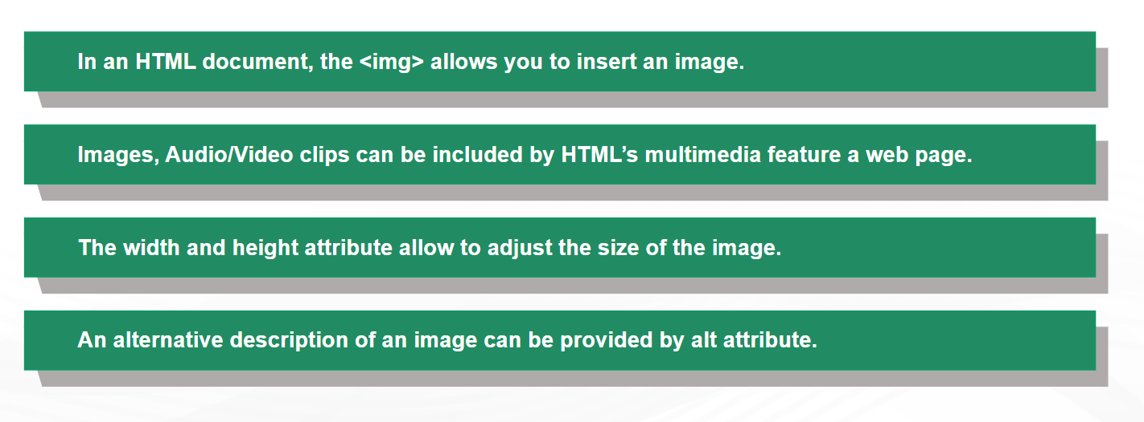
HTML Image

Slide 25
Image Tag
There are 2 ways to insert the images into a webpage:
By providing a full path or address (URL) to access an internet file.
By providing the file path relative to the location of the current web page file.
Syntax:
<img> : To add an image into the page you need to use an <img> element. This is an empty element.
src: Specifies the path to the image file.
alt: Provides alternate text for the image, useful for accessibility and when the image cannot be displayed.
width, height: Specifies the height of the image.

Slide 26
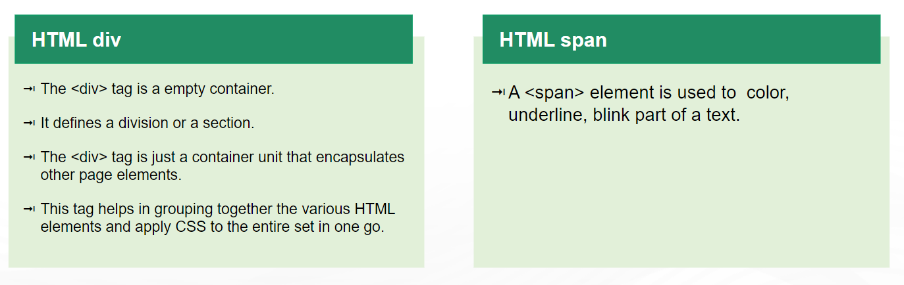
HTML Div and Span

Slide 27
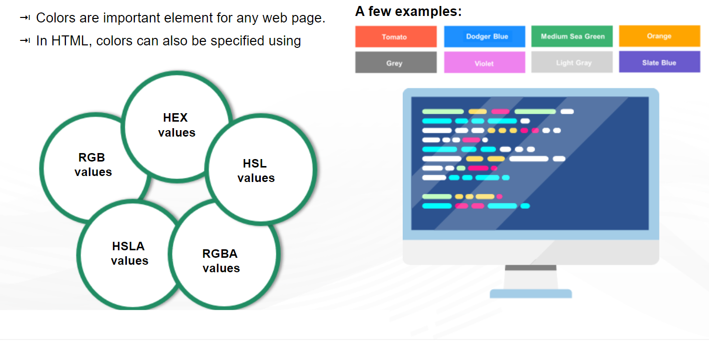
HTML color

Slide 28
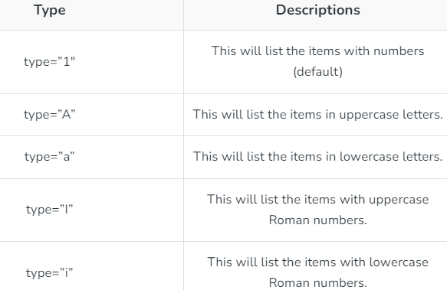
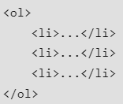
Lists
Ordered lists: <ol> and <li>: lists where each item in the list is numbered.
Syntax:

Slide 29
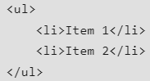
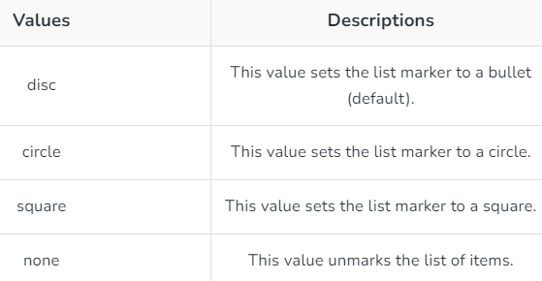
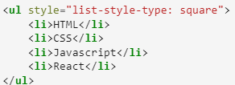
Unordered lists : <ul> and <li>: lists that begin with a bullet point (rather than characters that indicate order).
Syntax:
Example:

Slide 30
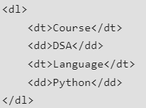
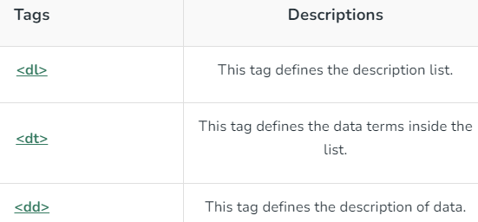
Description lists : <dl>, <dt> and <dd>: Items are paired with descriptions.
Syntax:

Slide 31
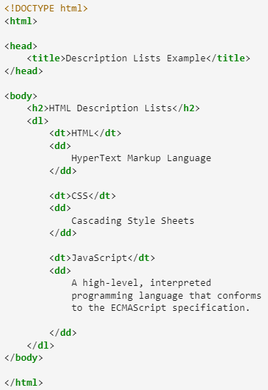
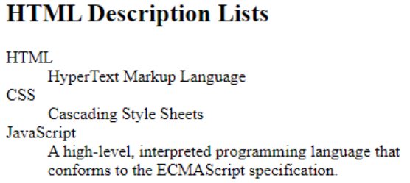
Output:

Slide 32
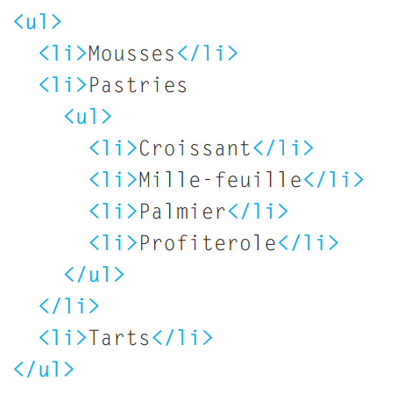
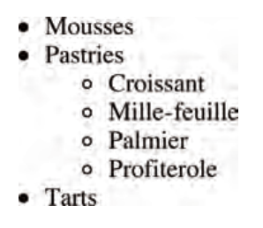
Nested Lists
You can put a second list inside an <li> element to create a sublist or nested list

Slide 33
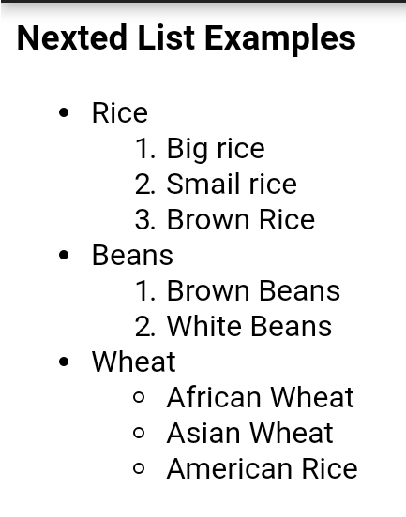
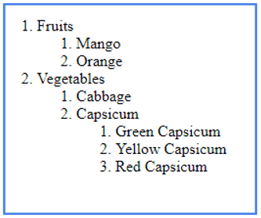

Slide 34
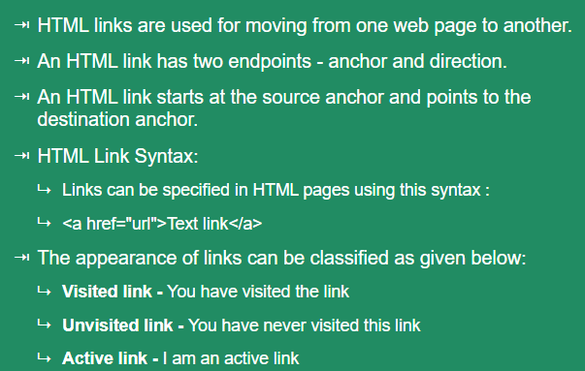
HTML Links

Slide 35
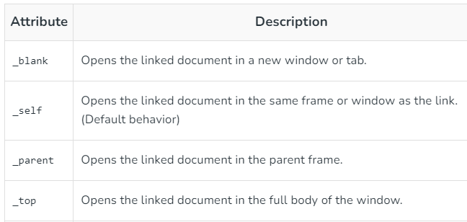
HTML Links - The target Attribute
By default, the linked page will be displayed in the current browser window. To change this, you must specify another target for the link.
The target attribute specifies where to open the linked document.
The target attribute can have one of the following values:
***Frameset is not supported in HTML5

Slide 36
Basic Hyperlink
<body>
<p>Click on the following link</p>
<a href="https://www.thapar.edu">TIET </a>
</body>
Using target Attributes
<body>
<p> If you set the target attribute to "_blank", the link will open in a new browser window or tab. </p>
<a href="https://www.thapar.edu" target="_blank"> TIET </a>
<p> If you set the target attribute to "_self", the link will open in the same window or tab. </p>
<a href="https://www. thapar.edu" target="_self"> TIET </a>
<p> If you set the target attribute to "_top", the link will open in the full body of the window. </p>
<a href="https://www. thapar.edu" target="_top"> TIET </a>
<p> If you set the target attribute to "_parent", the link will open in the parent frame. </p>
<a href="https://www. thapar.edu" target="_parent"> TIET </a>
</body>

Slide 37
Absolute URLs vs. Relative URLs:
A local link (a link to a page within the same website) is specified with a relative URL (without the "https://www" part):
<h2>Absolute URLs</h2> <p><a href="https://www.thapar.edu/">TIET</a></p> <p><a href="https://www.google.com/">Google</a></p> <h2>Relative URLs</h2> <p><a href="html_images.asp">HTML Images</a></p> <p><a href="/css/default.asp">CSS Tutorial</a></p>

Slide 38
HTML Links - Use an Image as a Link
Link to an Email Address
To use an image as a link, just put the <img> tag inside the <a> tag.
<a href="default.asp"> <img src="smiley.gif" alt="HTML tutorial" style="width:42px;height:42px;"> </a>
Use mailto: inside the href attribute to create a link that opens the user's email program (to let them send a new email):
<a href="mailto:someone@example.com">Send email</a>

Slide 39
Tables in HTML
HTML Tables are one of the best ways to place the data in an arranged format.
Basic Structure
<table>: Defines the table.
<tr>: Defines a table row.
<th>: Defines a header cell.
<td>: Defines a data cell.

Slide 40
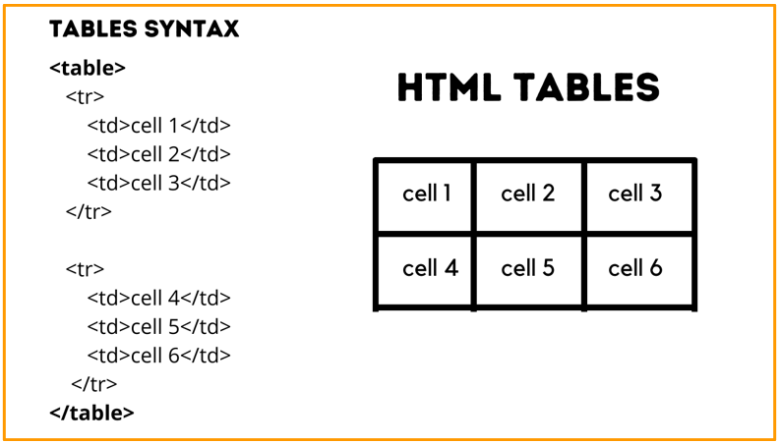

Slide 41
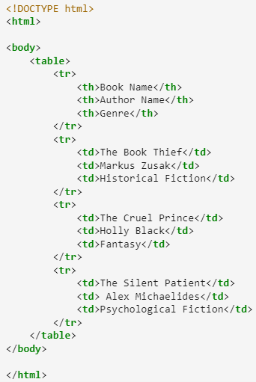
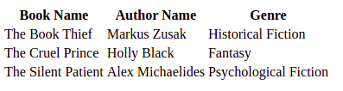

Slide 42
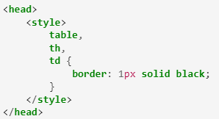
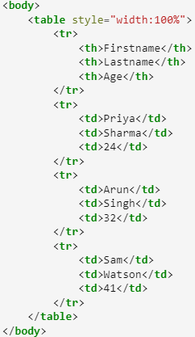
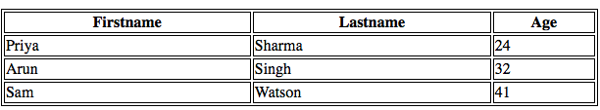
Adding a border to an HTML Table

Slide 43
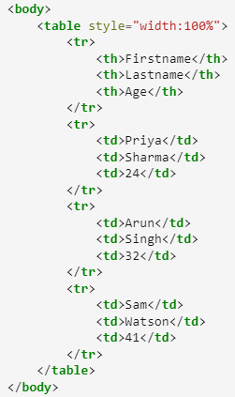
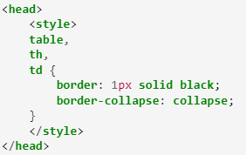
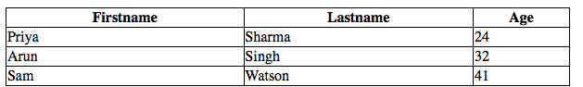
Adding Collapsed Borders in an HTML Table

Slide 44
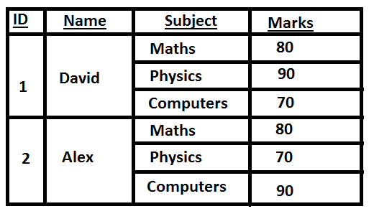
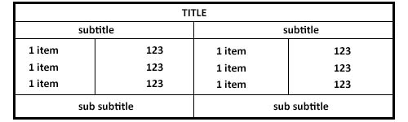
Row Span and Column Span
Row Span : entries in a table to stretch down across more than one row.
Column Span: entries in a table to stretch across more than one column

Slide 45
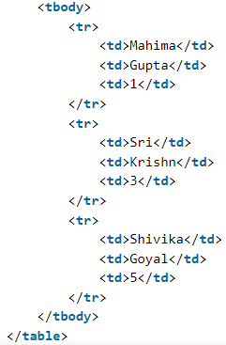


Column Span
HTML Table with Colspan allows you to merge or combine adjacent table cells horizontally, creating a single, wider cell that spans across multiple columns.
The colspan is defined as the <th> element.

Slide 46


Row Span
The HTML attribute rowspan determines how many rows a specific cell in a table should cover. When a cell spans multiple rows, it occupies the space of those rows within the table.
Applied within a <td> or <th> element.

Slide 47





Slide 48


Practice Example:

Slide 49

HTML Attributes

Slide 50

HTML Core Attribute
Attributes that are used in majority of HTML pages are:

Slide 51
<!DOCTYPE html>
<html>
<head>
<style>
#abc {
color: green;
}
</style>
</head>
<body>
<h2>Welcome to this page</h2>
<h1 id=“abc">Hi!</h1>
</body>
</html>
Welcome to this page
Hi!
Note: In HTML5, id attributes can be used by any HTML tag but in HTML 4.01 there are some restriction to use id attributes. It can not be used by <base>, <head>, <html>, <meta>, <param>, <script>, <style>, and <title> tag. In HTML4.01 id can not start with number.

Slide 52
HTML Id attribute use cases:
The id attribute in HTML uniquely identifies elements, enabling targeted selection and manipulation via CSS and JavaScript for specific functionality and styling.
The id attribute uniquely identifies one element, while the class attribute can be applied to multiple elements for shared styling.
Valid values for the id attribute in HTML are unique identifiers consisting of letters, numbers, hyphens, underscores, and colons, starting with a letter or underscore.
To select an element by ID in JavaScript, use the getElementById() method followed by the ID name enclosed in quotes.

Slide 53
Class attribute
The HTML class attribute is used to assign one or more CSS classes to an HTML element.
Classes define styling rules, allowing elements with the same class to share visual properties defined in CSS.
The HTML class attribute can be applied to various tags, allowing multiple elements to share a common classification.
This enables consistent styling or functionality across different types of elements, enhancing design cohesion and simplifying maintenance.

Slide 54




Slide 55



Using multiple HTML class attribute

Slide 56
HTML Class Attribute Use Cases
The class attribute in HTML assigns elements to groups, enabling targeted styling or functionality application via CSS or JavaScript.
Use class for multiple elements with shared characteristics; use id for unique identification or targeting specific elements individually.
Supported Browser: The browser supported by Class attribute are listed below :
Chrome 15 above
Edge 12 and above
Firefox 1 and above
Opera 14 and above
Safari 6 and above

Slide 57
HTML title Attribute
The title attribute is used to specify extra information about the element. When the mouse moves over the element then it shows the information.
Supported Tags: It supports all HTML elements.
Syntax:
Attribute Value: This attribute contains single value text which is used as the tooltip text for an element. This title is associated with all HTML elements.

Slide 58

<!DOCTYPE html>
<html>
<head>
<title>title attribute</title>
<style>
body {
text-align: center;
}
h1 {
color: green;
}
</style>
</head>
<body>
<p title=“Thapar Institute of Engg. And Technology">
TIET
</p>
</body>
</html>

Slide 59

HTML lang Attribute
This attribute is used to specify the language of the element content. Some examples of languages are en for English, es for Spanish, etc.
Syntax:
.
Attribute Value: This attribute contains a single value language_code which is used to specify the language of the content.
Difference between HTML 4.1 and HTML 5: In HTML 5, the lang attribute can be used with any HTML element but in HTML 4.1 the lang attribute is used with <base>, <br>, <frame>, <frameset>, <hr>, <iframe>, <param>, and <script> elements

Slide 60
<!DOCTYPE html>
<html>
<head>
<title>lang attribute</title>
<style>
body {
text-align:center;
}
h1 {
color:green;
}
</style>
</head>
<body>
<h1>TIET</h1>
<h2>lang attribute</h2>
<p lang="en"> CSED </p>
</body>
</html>
TIET
lang attribute
CSED

Slide 61
HTML Style Attribute
Styles in HTML are rules that describe how a document will be presented in a browser.
Style information can be either attached as a separate document or embedded in the HTML document.
There are 3 ways of implementing style in HTML.
Inline Style
Embedded Style
External Style Sheet

Slide 62
Inline Style:
In Inline styling, the CSS rules are directly written inside the starting tag using the style attribute.
The style attribute includes a series of CSS properties and value pairs. Each ‘ property: value ‘ pair is separated by a semicolon ( ; ).
This attribute will override the style properties globally for any relevant style set.

Slide 63



Slide 64
Embedded Style:
Embedded or internal style sheets only affect the document they are embedded in.
Embedded style sheets are defined in the <head> section of an HTML document using the <style> tag.

Slide 65




Slide 66
External Style Sheet:
External Style Sheets method can be useful when the CSS has to be applied to various web pages.
An external style sheet holds all the style rules in a separate document that you can link from an HTML file on your site.
There are two ways of attaching external style sheets:
Linking External Style Sheets: In this method, an external style sheet is linked to an HTML document using the <link> tag.
Importing External Style Sheets: External style sheets can be loaded into an HTML document using “@import“. The “@import” statement instructs the browser to load the CSS file. Other CSS rules can also be included using the <style> element.

Slide 67



Slide 68



Slide 69

HTML Generic Attributes

Slide 70

HTML src Attribute

Slide 71

HTML alt Attribute

Slide 72

Forms in HTML
HTML borrows the concept of a form to refer to different elements that allow you to collect information from visitors to your site .
HTML Forms utilize the <form> element as a powerful tool to collect user input through a variety of interactive controls.
Allows users to submit data to a server.

Slide 73

How Forms Work
A form may have several form controls, each gathering different information. The server needs to know which piece of inputted data corresponds with which form element
To differentiate between various pieces of inputted data, information is sent from the browser to the server using name/value pairs .

Slide 74
Form Structure
<form> : Form controls live inside a <form> element.
Action : Every <form> element requires an action attribute. Its value is the URL for the page on the server that will receive the information in the form when it is submitted.
Method : Forms can be sent using one of two methods: get or post.
With the get method, the values from the form are added to the end of the URL.
With the post method the values are sent in what are known as HTTP headers

Slide 75

Example

Slide 76

Form Elements
The HTML <form> comprises several elements, each serving a unique purpose.

Slide 77


Slide 78
<label> element
The <label> HTML element represents a caption for an item in a user interface.
It enhances accessibility by associating text with form elements.
When clicked, it focuses on or activates the associated element, improving usability and providing descriptive context for inputs like text fields, checkboxes, or radio buttons.
The <label> tag can be used in 2 ways:
Firstly, use the <label> tag by providing the <input> and id attributes. The <label> tag needs an “for” attribute whose value is the same as the input id.
It uses the for attribute to connect the label with the id of the form element, its labeling
Alternatively, the <input> tag is used directly inside the <label> tag. In this case, the for and id attributes are not needed because the association is implicit.

Slide 79




Slide 80



input tag inside the label tag

Slide 81

<input> tag
<input> tag specifies an input field where the user can enter data.
It’s fundamental for web forms, enabling diverse input methods like text, password, checkboxes, radio buttons, file uploads, and more.
The default value accepted by the <input> tag is text.
An input field can be of various types depending upon the attribute type.
The Input tag is an empty element that only contains attributes.
For defining labels for the input element, <label> can be used.

Slide 82

The <input> element in HTML4

Slide 83
<input> attributes
Attributes | Description
type | It is used to specify the type of the input element. Its default value is text.
value | It is used to specify the value of the input element.
placeholder | Placeholder attribute is used to specify hint that describes the expected value of an input field.
name | It is used to specify the name of the input element.
alt | It is used to provide alternate text for the user, if they cannot view the image.
autofocus | It specifies that an element should automatically get focus when the page loads.
checked | It specifies that an element should be pre-selected (checked) when the page loads.

Slide 84
Example

Slide 85




<select>
The <select> tag in HTML creates a drop-down list for user input, containing <option> tags to display available choices. It supports attributes like autofocus, disabled, multiple, name, required, and size to enhance functionality and usability in forms.
Syntax:

Slide 86
<option>
HTML <option> tag is a versatile tool that enhances user interaction by creating selectable options within a dropdown list.
This tag can be used with or without any attributes, and the selected value can be sent to the server.
This elements must be inside <select> tag, <optgroup>, or <datalist> tags. It represents an individual option within a <select> dropdown, allowing users to choose among multiple choices.
Syntax:

Slide 87


Slide 88





Slide 89
<button>
<input type=”button”> and <button> tag are two different approach to use Button in HTML document.
The difference between them is that the buttons created with the <button> tag offer many contributing possibilities than <input type=”button”> attribute.
The <button> can have content inside it. The <button> tag permits phrasing content inside button element contents like text or images etc, along work with type functionality defined.
But the input type=”button” attribute does not permit content. For example, a button tag that contains an image functions and may resemble an input tag whose type is set to “image”, but the button element type allows content.
Note: The <button> tag uses opening and closing bracket but <input type=”button”> attribute uses only single tag.

Slide 90




After clicking the button:

Slide 91



After clicking the button:

Slide 92



Slide 93

The <input> element in HTML5

Slide 94



Slide 95



Slide 96



Slide 97
HTML5: Form Validation
2 types of form validations are : Client-side (HTML5,JavaScript)and Server-side (Back-end scripts)
Traditionally, form validation has been performed using JavaScript.
But HTML5 is introducing validation and leaving the work to the browser.
Validation helps ensure the user enters information in a form that the server will be able to understand when the form is submitted.

Slide 98
Basic HTML5 Validation Attributes
required: Ensures a field is not left empty.
pattern: Validates input against a regular expression.
min and max: Sets the range of acceptable values.
maxlength: Limits the number of characters.
type: Specifies the type of input.

Slide 99


Validation Example

